Slide 1
2 - IBFE Tutorial: Make your own mesh and move it!

Slide 2
Homework: Make your own mesh and move it
Copy the example 1-IBFE-Example_TetherForceFullPlate2D and rename it something like MyIBFE_Example -TetherForceFullTriangle2D.
Download gmsh – version ??? — we previously used 2.9.0.

Slide 3
I plan to make a triangle
I will add the points (0.5,0), (0,0) and (0,0.5).
Remember you want to select these so they will fit in your domain.
Although you can change the scaling later, it’s probably best to do this with the right dimensions from the beginning.
The size of the domain in this example is L=2.0. It runs from -L/2 to L/2 in each direction.
My triangle fits well within the domain.

Slide 4
From input2d
// physical parameters
MU = .01
RHO = 1.0
L = 2.0
// grid spacing parameters
MAX_LEVELS = 2 // maximum number of levels in locally refined grid
REF_RATIO = 4 // refinement ratio between levels
N = 32 // actual number of grid cells on coarsest grid level
NFINEST = (REF_RATIO^(MAX_LEVELS - 1))*N // effective number of grid cells on finest grid level
DX0 = L/N // mesh width on coarsest grid level
DX = L/NFINEST // mesh width on finest grid level

Slide 5
Making the mesh
From here we will make the mesh, but we need to consider a couple things first.
In this example, the finest mesh is effectively 128x128 (coarsest grid is 32x32, there are 2 levels and a 4:1 refinement ratio).
We want the ratio of the finite element mesh to the Cartesian mesh to be 1:1. We will therefore pick a meshwidth of L/NFINEST = 2.0/128 = 1/64 = 0.0156.

Slide 6
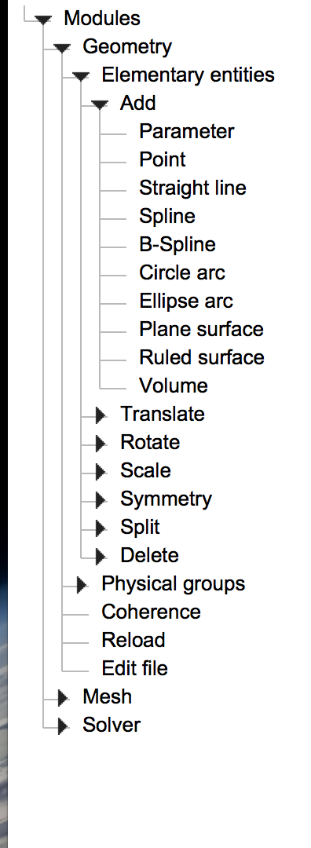
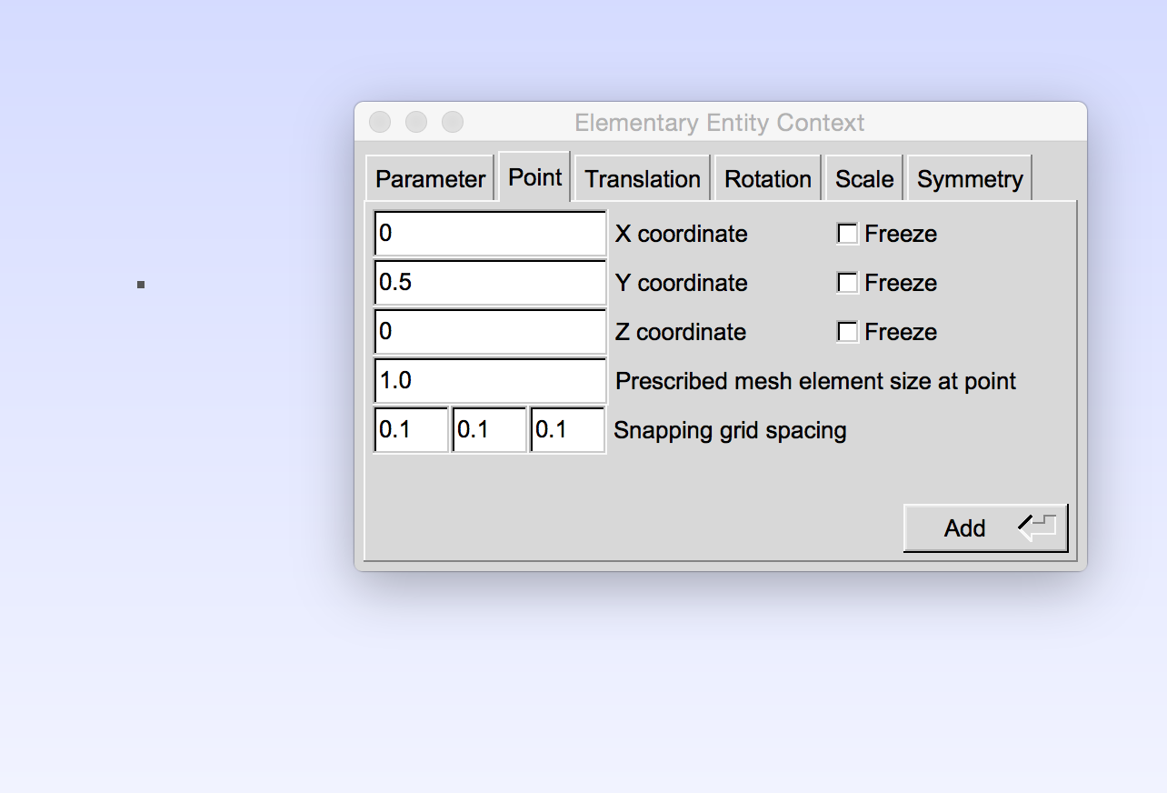
Adding points to workspace
Modules -> Geometry -> Elementary entities -> Add -> Point
If using the mouse to place points, you can change the snap value to get more or less precision in placement
Type point pos.
Place point w/ mouse
Either type coordinates for point, or use mouse to place it in the canvas (press e to place the point when positioning it with the mouse). Press q when done adding points
Under prescribed mesh element point
size, change to 0.0156.

Slide 7
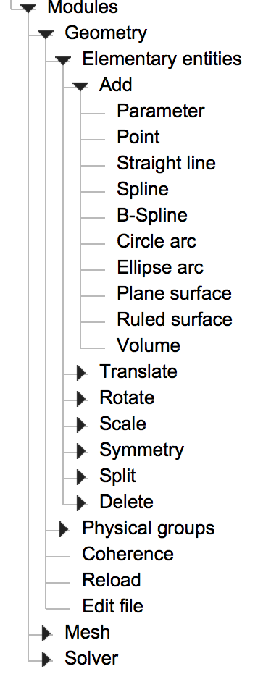
Connecting the points with lines
Modules -> Geometry -> Elementary entities -> Add -> [a line type, e.g. Straight line, Spline, Circle arc, etc.]
Follow on screen instructions for connecting the given points with the line type (e.g. if using straight line, just click the two points you want to connect with a line)

Slide 8
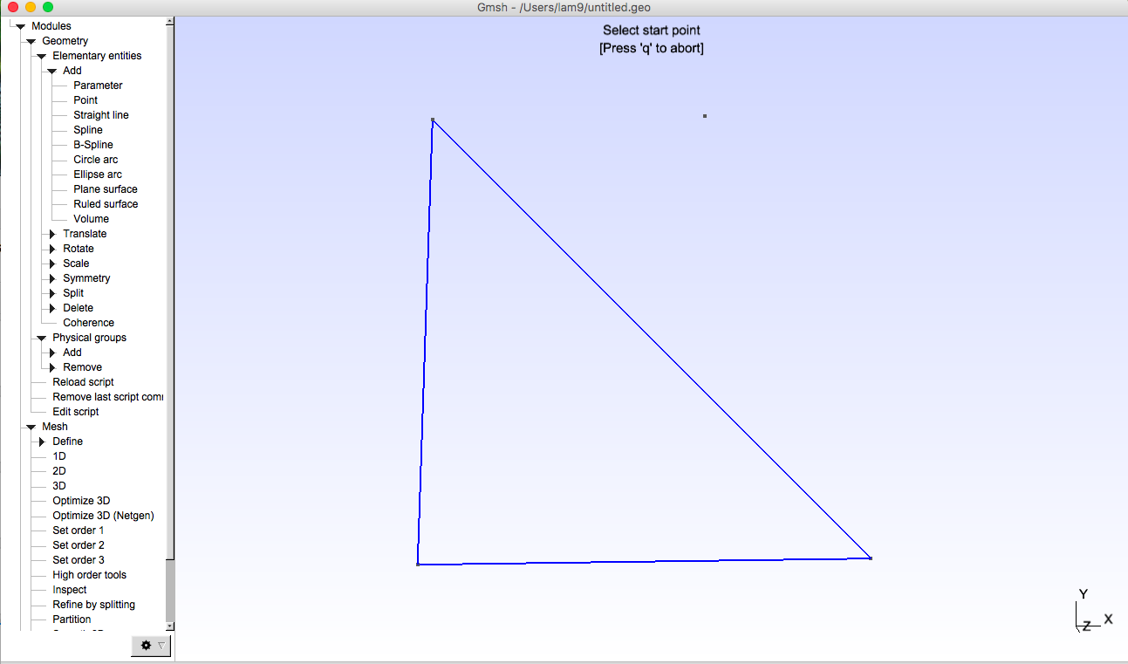

Slide 9
Making connected lines into a plane
Modules -> Geometry -> Elementary entities -> Add -> Plane surface
After selecting plane surface, click on border made from the lines that you placed and then press e. The plane is indicated by dashed lines in the middle of the border lines.

Slide 10
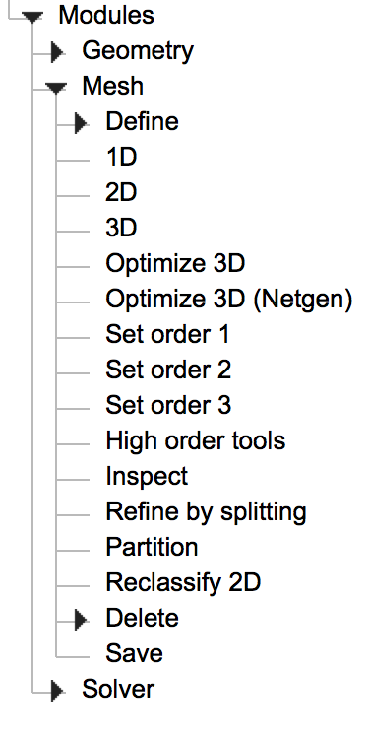
Mesh the plane
Modules -> Mesh -> 2D
Clicking 2D under the mesh menu automatically makes a mesh in the defined planes.
For some strange reason, you should click 1D and then click 2D to make it show up.

Slide 11
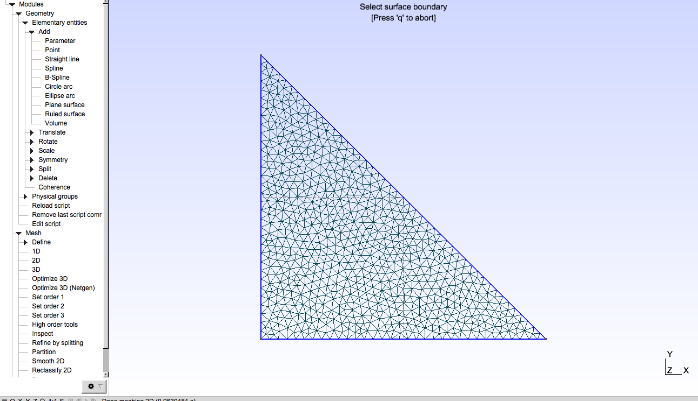

Slide 12
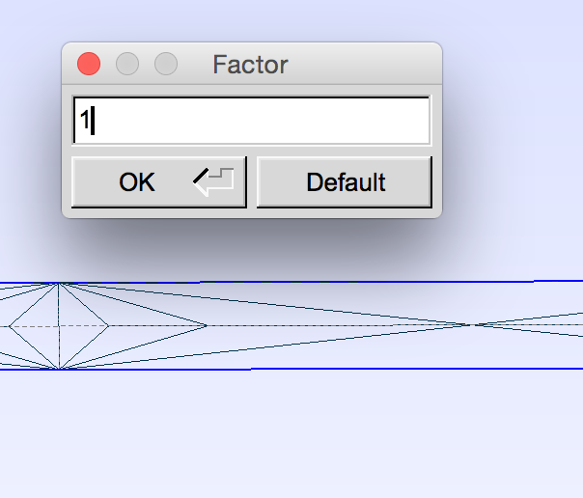
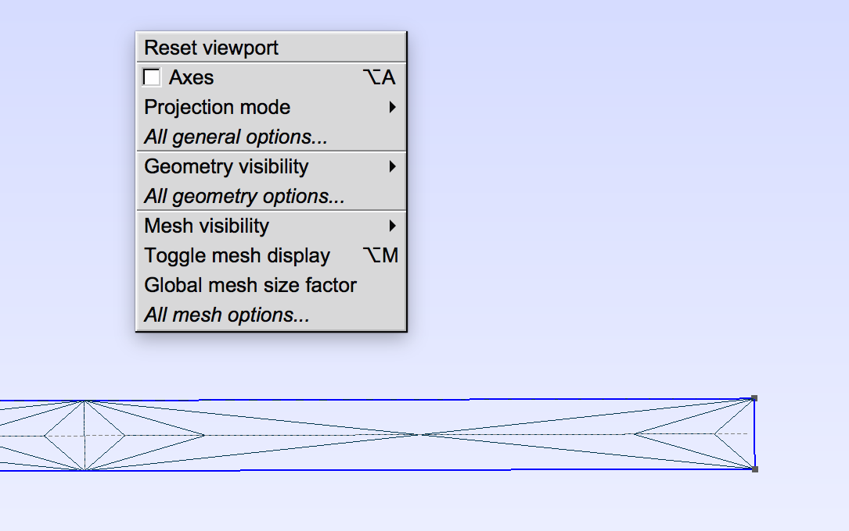
Changing the mesh
If you need to do this, click simultaneously with left and right mouse button to get a menu with workspace options. Click “Global mesh size factor” and type a new mesh size factor in the box (the default is 1). Click OK.
NOTE: to see the changes you made, click 1D and then 2D in the mesh menu (similar as above when you meshed the first time). This refreshes the mesh.

Slide 13
Save the file
Click file -> “Export…”, and choose the .msh file type in thedrop down list in the window that pops up. Type a name for your mesh file (ending in .msh), and you are done! Put this .msh file in the folder of your simulation and modify the main.C file to read in the mesh given by the file name that you made.

Slide 14
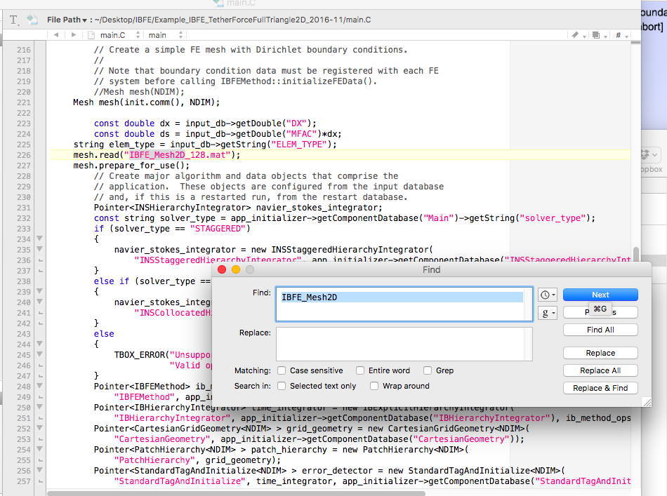
In main.C, search for IBFE_Mesh2D_128.mat, replace with triangle.msh

Slide 15
Changes to input2d
MFAC = 1.0 // ratio of Lagrangian mesh width to Cartesian mesh width
IB_POINT_DENSITY = 1.0 // approximate density of IB quadrature points for Lagrangian-Eulerian interaction
Did this to update to 1:1 ratio for boundary mesh size to Cartesian mesh size
You may also need to change DT to something smaller in input2d.

Slide 16
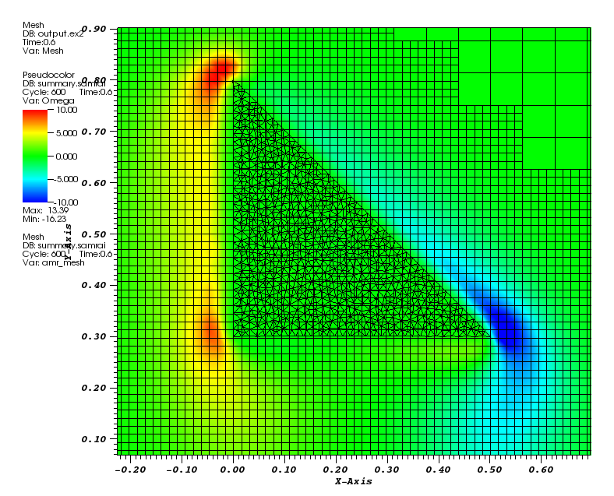
Run simulation - here is mine with both grids!

